Slide 1
EECS 398 :: 003, 004, 005 – Computing for Computer Scientists
Winter 2016
http://c4cs.github.io

Slide 2

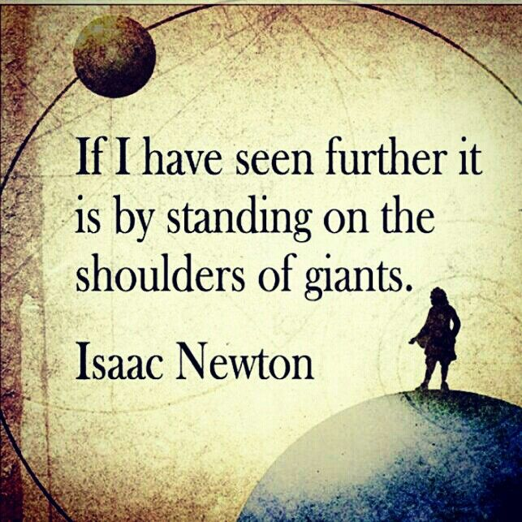
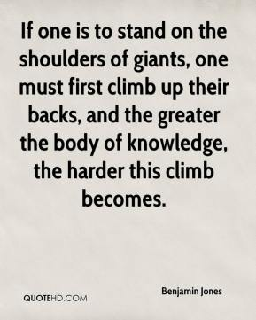
What this class is about

Slide 3
What this class is about
This is not “Tools for Computer Scientists”
Though we will teach you a lot of cool tools
The goal is to give you the ability to pick up, learn, and use tools effectively

Slide 4
This class is NOT a set of tutorials
Task: Write, compile, and run “Hello World”
Log in to a CAEN machine in Linux
Press the “windows” key to open the application launcher and then type “gedit”
Now copy-paste the following block of code into the window:
Type “Ctrl-s” or click the “save” icon, save the file as “myprogram.c” in your home directory.
Press the “windows” key again and type “terminal”
In the window that appears, type “gcc myprogram.c -o myprogram”
Now type “./myprogram”
Open your favorite text editor and write a basic “Hello World” program
Compile and run your program
#include <stdio.h>
int main() { printf(“Hello World\n”); return 0; }

Slide 5

Lectures give you the “what” and the “why”, homeworks are a self-guided tour on the “how”

Slide 6
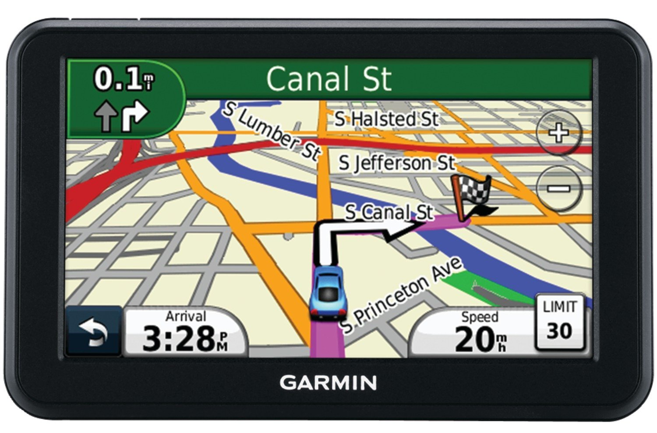
This is a very individual class
Nothing in this class is hard…
  The second time you do it

Slide 7
This class is unlike any other class in engineering, especially CSE
Collaboration discouraged
  At least until after you are done
It will benefit you only if you do the work
  It’s only 1-credit…

Slide 8



Course Resources
Everything starts from the course homepage:
http://c4cs.github.io
cTools only has a link to the course homepage
Syllabus, announcements, office hours, assignments, etc
Q&A, Help forum
Assignment submission, grading, and re-grades
You should have received accounts for both of these, if not e-mail c4cs-staff@umich.edu

Slide 9
Private Piazza Questions Only Please
Questions are private by default
May be useful as “digital office hours”
Q&A, Help forum

Slide 10
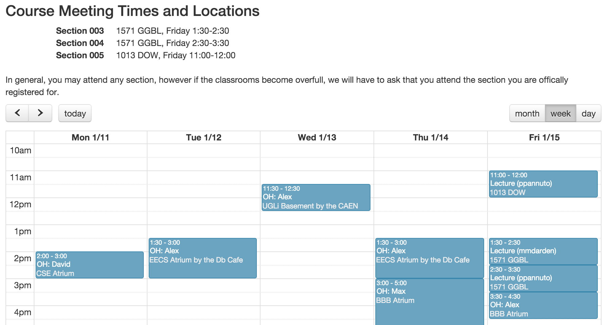
If this looks like a screenshot of a website, that’s because it is.
Because all information is on the course homepage
http://c4cs.github.io/#times

Slide 11
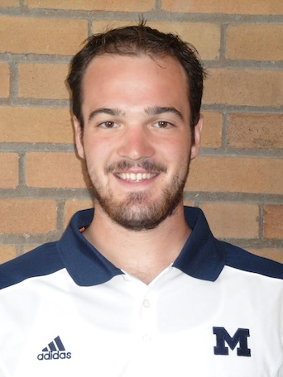
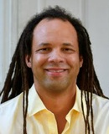
Two Lecturers – Both Awesome
Pat Pannuto
Marcus Darden
Looking for contact info? You guessed it, course website: http://c4cs.github.io

Slide 12
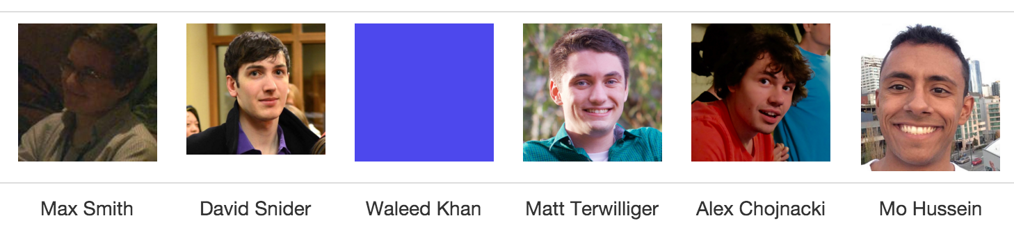
Six IA’s – Even Awesomer
Is this another screenshot of that super-awesome, has-all-the-information, course website?
Why yes, yes it is.
http://c4cs.github.io

Slide 13
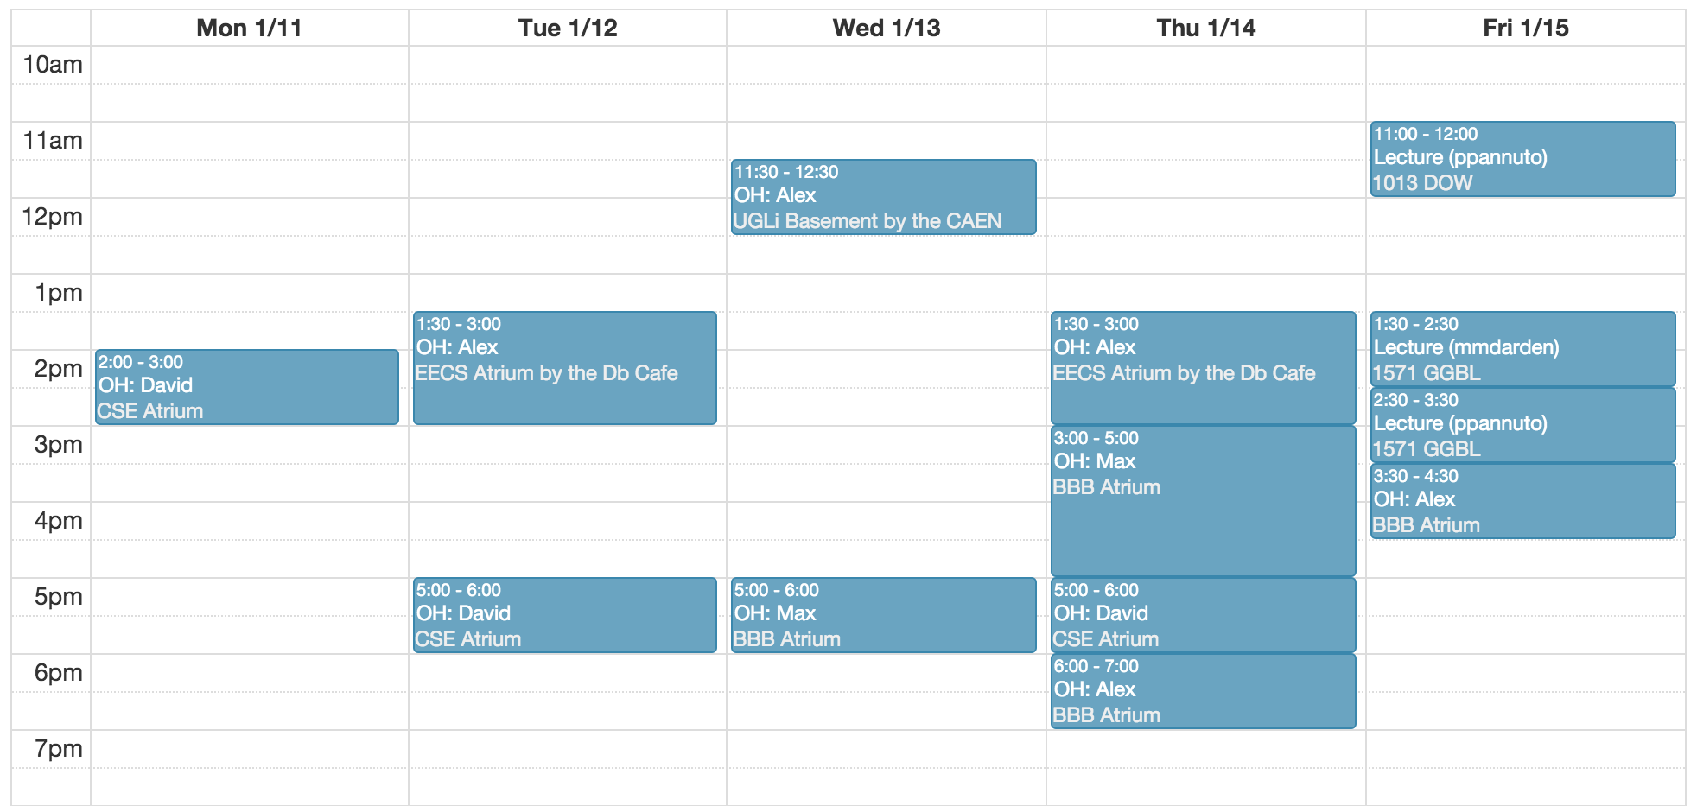
Lots of Office Hours
Assignments will require trial and error

Slide 14
Speaking of assignments… Grading and the like
Attendance (25%)
  Answer question at the beginning of each lecture
  Correct: 2pts, Incorrect: 1pt, No Answer: 0pts
  Max is 13 x 2 = 26pts (spring break optional)
Homeworks (25%)
  Target: 1-4 hours of work / week
  Graded on a {0, 1, 2} scale (all, some, or none)
  Max is 12 x 2 = 24pts (no spring break, no last week)
Advanced Exercises (25%)
  Goal: Guided way to learn more about a topic you think is cool
  Graded on a {0, 1} scale (all or none)
  Each homework has (at least) one, must pick at least 3 of 12
Final Exam (25%)
  Time and date TBA ASAP (sorry…, Friday-only lecture made it weird)
Looking for more details, questions? http://c4cs.github.io/#grading

Slide 15
Speaking of assignments… Grading and the like
Attendance (25%)
  Answer question at the beginning of each lecture
  Correct: 2pts, Incorrect: 1pt, No Answer: 0pts
  Max is 13 x 2 = 26pts (spring break optional)
Homeworks (25%)
  Target: 1-4 hours of work / week
  Graded on a {0, 1, 2} scale (all, some, or none)
  Max is 12 x 2 = 14pts (no spring break, no last week)
Advanced Exercises (25%)
  Goal: Guided way to learn more about a topic you think is cool
  Graded on a {0, 1} scale (all or none)
  Each homework has (at least) one, must pick at least 3 of 12
Final Exam (25%)
  Time and date TBA ASAP (sorry…, Friday-only made it weird)
Last chance for
administrative questions
Looking for more details, questions? http://c4cs.github.io/#grading

Slide 16
Pre-Req: You have your own computer
CAEN machines are NOT sufficient for this class
If you don’t have your own computer…
  Dog ate it
  TSA confiscated it on your flight home
  Drunk roommate confused it for a frisbee
The CSE department will give you a loaner laptop for the semester for free
Contact Don Winsor: don@umich.edu

Slide 17
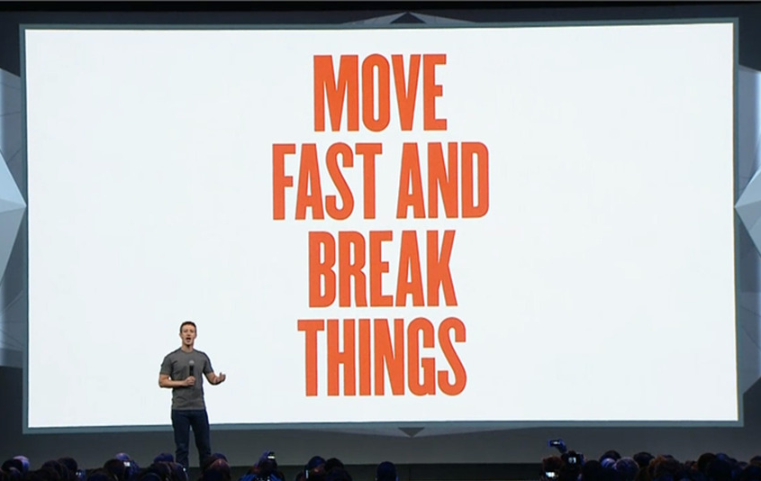
Speaking of assignments… What’s on tap for this week?
In this class, we want you to explore, to
We also don’t want to cause any trouble for all the other classes you’re taking…

Slide 18
Wouldn’t it be great if you had another computer, just for this class?
That’s a good idea. Let’s do that.

Slide 19
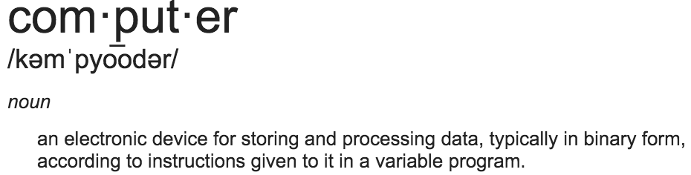
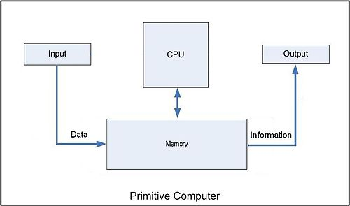

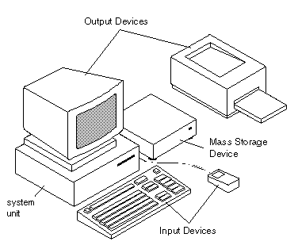
Enter the Philosophers:
What is a computer?
Aside: My Google Image search for “what is a computer” was really disappointing, 90’s clip art, really?

Slide 20
What does a computer do?
Runs programs, such as
This Presentation
This Presentation
Application Data
PowerPoint for Mac
PowerPoint
Application
“El Capitan”
(OS X)
Windows 8
Operating System
My Macbook
My Desktop
Computer

Slide 21


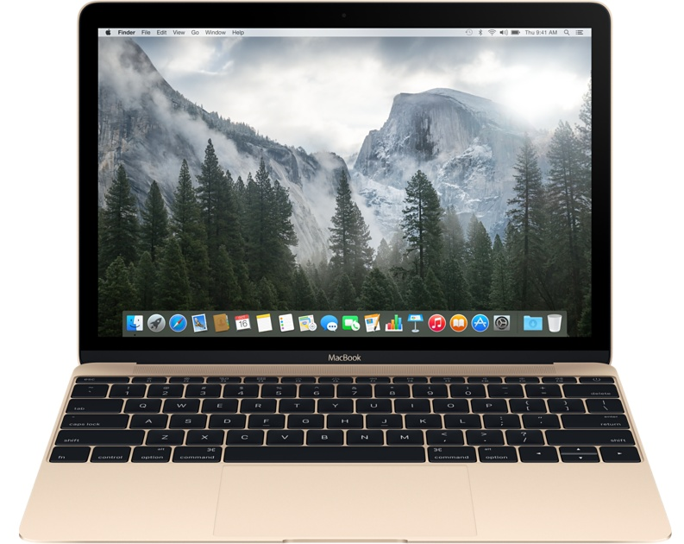


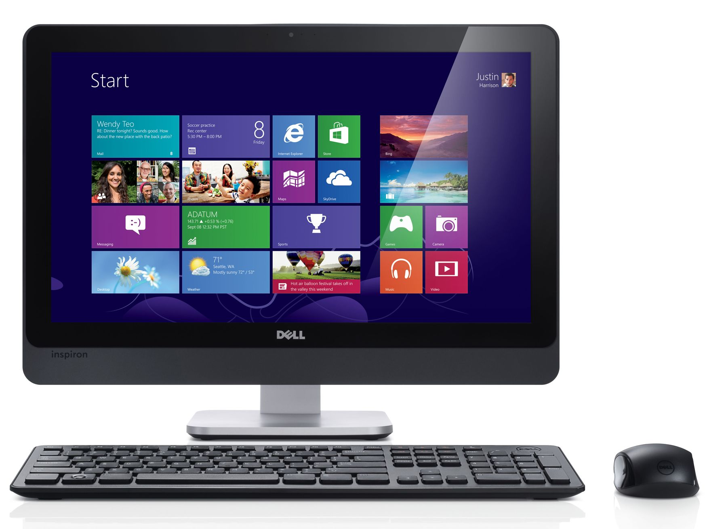
Computing is all about abstractions
Syscall ABI
BIOS

Slide 22

Can I run PowerPoint for Windows on my laptop?
Syscall ABI
BIOS

Slide 23

A “Virtual Machine” is a program that pretends to be computer hardware
PC-like BIOS
Apple BIOS
OS X Syscall ABI
Windows Syscall ABI

Slide 24


And a “Virtual Machine Manager” can create many virtual machines on one physical machine
PC-like BIOS
Linux Syscall ABI
Apple BIOS
OS X Syscall ABI
PC-like BIOS
Windows Syscall ABI

Slide 25
Virtual Machines…
Are software programs that “look like” hardware
Power much of the modern Internet
  “The Cloud” is warehouses full of thousands of machines pretending to be hundreds of thousands of machines
    AWS
    Google Cloud Compute
    Azure

Slide 26
There has been a LOT of work in VMs over the years
Caveat: This overview cut many corners
  Think this stuff is cool?
    EECS 482 is for you
    Perhaps also EECS 373
We will use a VM for everything in this course
  Consistent “machine” for 450 students
  Safe space for you to experiment
Check out some links on the course homepage if you’re interested in fancier things

Slide 27
Some final thoughts
This will be the only all-powerpoint lecture of the year
This is a brand new class
  That we opened to 450 people…
    Patience will be necessary at times
  Feedback is good

Slide 28
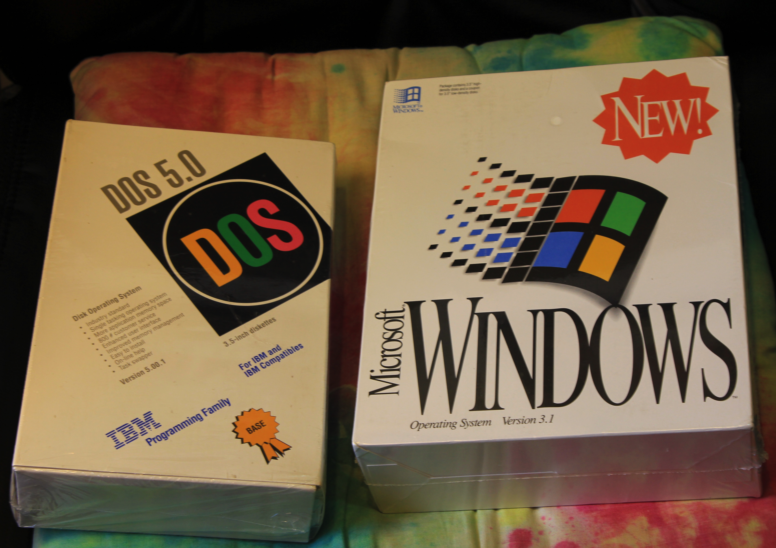
EECS 482 in 5 Minutes or Less
Foo

Slide 29
Unix is turtles all the way up:
“Programs” are basically functions
// Append a copy of the null-terminated string s2 to the end of the null-terminated string s1, then add a terminating `\0'. The string s1 must have sufficient space to hold the result.
char* strcat(char* s1, char* s2)
{
char* s1_end = s1[strlen(s1)];
strcpy(s1_end, s2);
return s1;
}

